Slide 1



Advanced Python Lab

Slide 2
Project Overview
Objective: To analyze trends in Netflix shows by country, year, and genre using data analysis and visualization techniques in Python.
Key Questions:
When were the most shows added?
Which countries produce the most Netflix shows?
What are the most common genres?

Slide 3
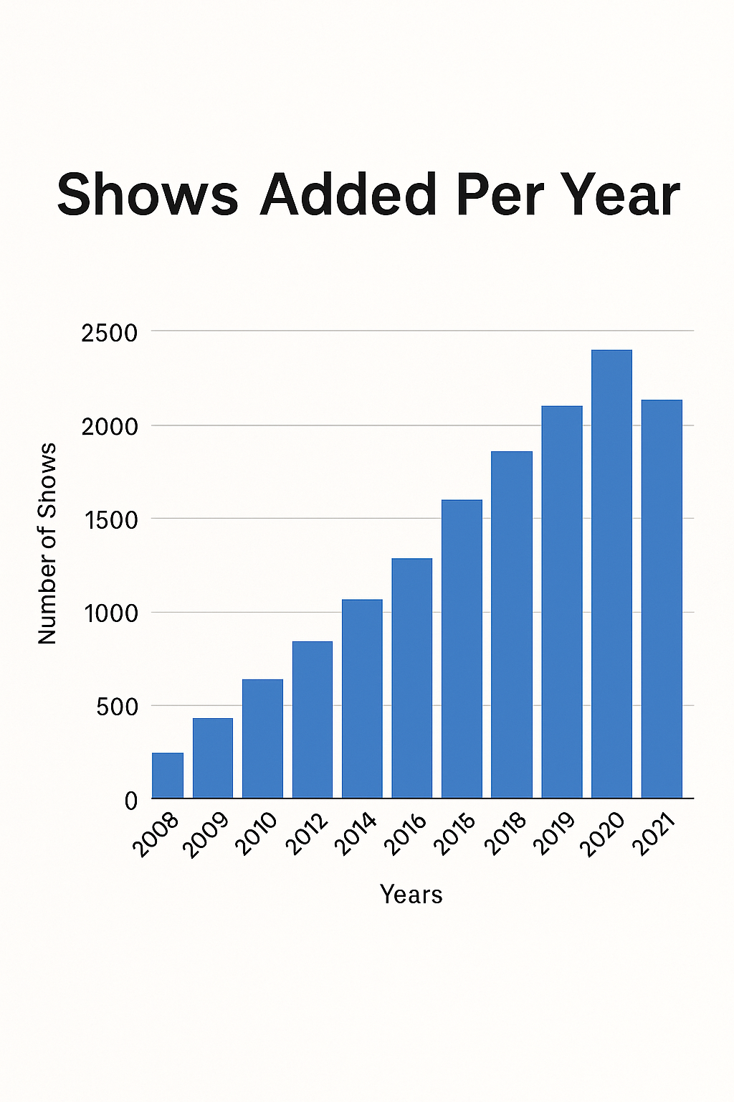
Shows Added Per Year
Insights:
Dramatic growth in content after 2016
Peak around 2018–2020

Slide 4
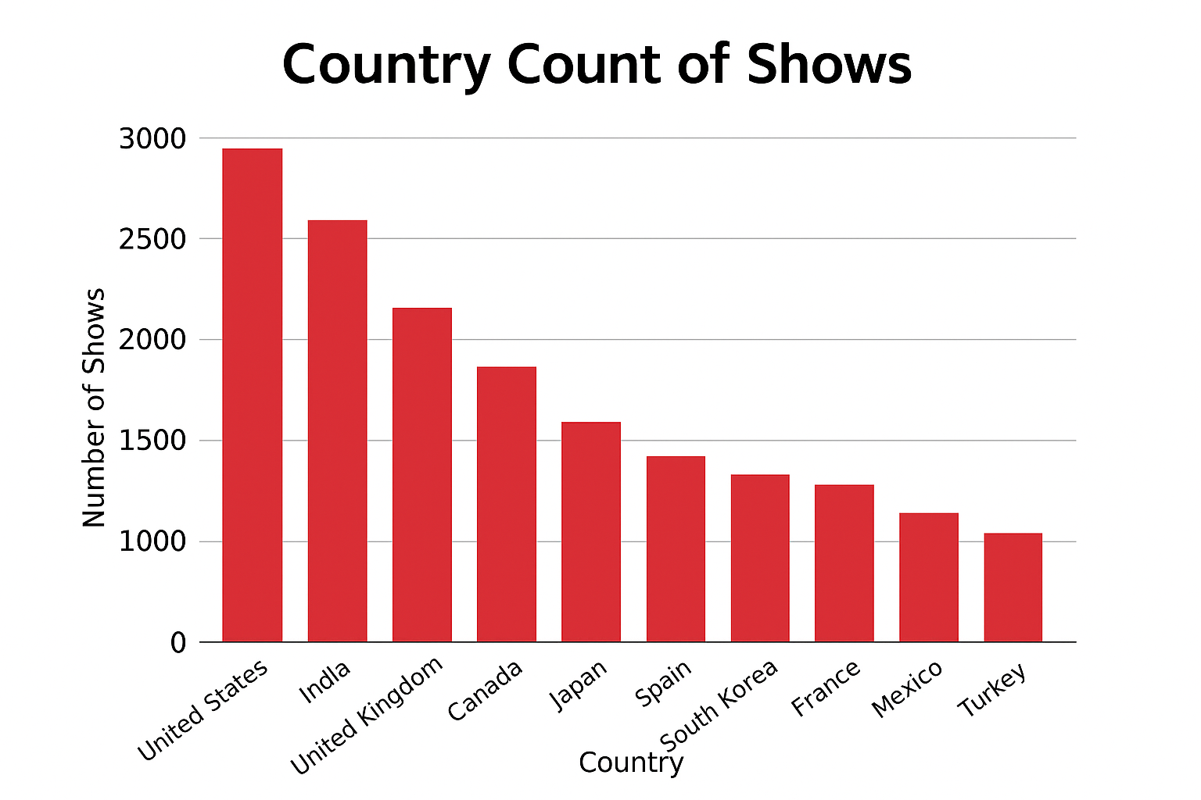
Country-wise Distribution
Insights:
USA leads in Netflix content
India, UK, and Canada follow

Slide 5
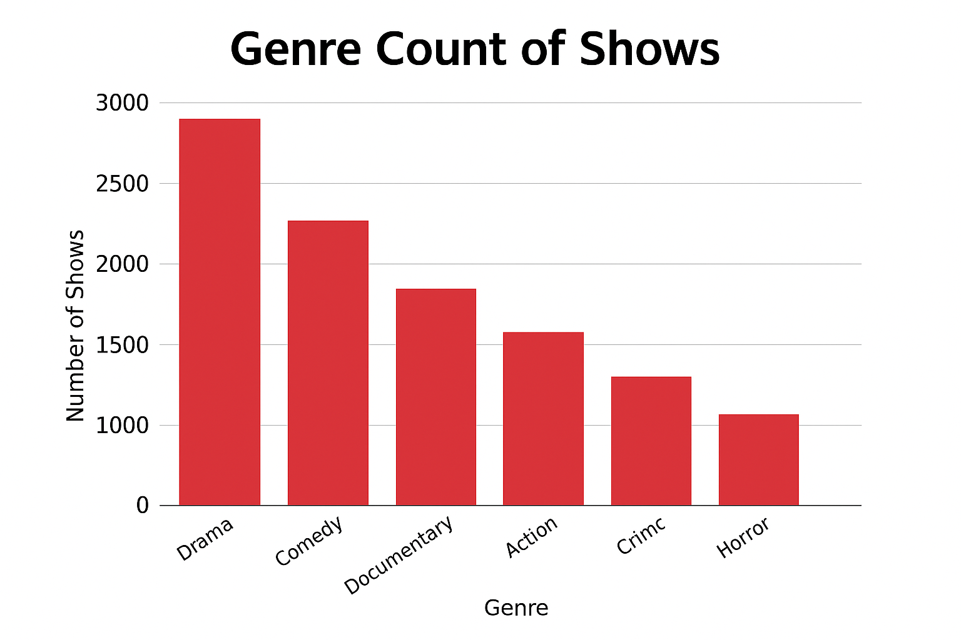
Genre Analysis
Insights:
Drama and Comedy dominate Netflix content
Documentaries and Action & Adventure
are also popular

Slide 6
Tools and Techniques
Programming Language – Python
Libraries used –
Pandas – data cleaning and anaylsis
Matplotlib – data visualization
Seaborn – data visualization

Slide 7
Conclusion
Netflix has expanded rapidly in recent years
USA dominates the Netflix catalog
Drama & Comedy are the most frequent genres

Slide 8
Thank You!
Thank you for watching!
Project by: Divya Chauhan
Gayatri Chauhan
Diya Bhandari
Ishika Singh
Feel free to ask any questions.

